Slide 1

Data Visualization: Turning Statistics into Art
DAVID BERBERENA
DSC 500 Intro to Data Science
Ismaily fall 2023

Slide 2
Data visualization is the process of taking cleaned data and displaying it for the average person to read and understand the intended meaning clearly by way of graphs, tables, charts, plots, and other graphical displays
What exactly does this visualization process do for a business?

Slide 3
Big Business Benefits
Companies have large data stores that very few people can make heads or tails of. Data visualization can help businesses with the following:
Breaking down data into a digestible amount that focuses only on the business problem at hand
Displaying the cleaned data for people who are not experienced in sifting through data to see the results and gain meaningful understanding
Showing patterns that were not previously discernable to help with future-oriented, data-driven decisions

Slide 4

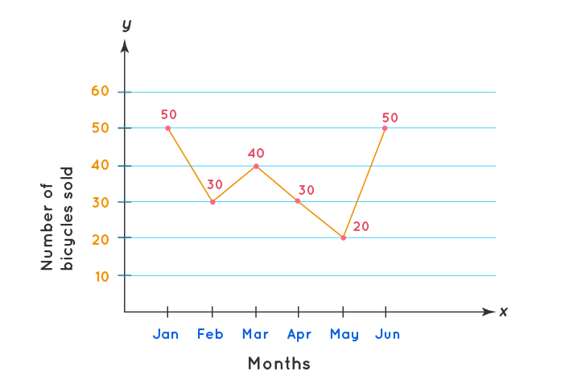
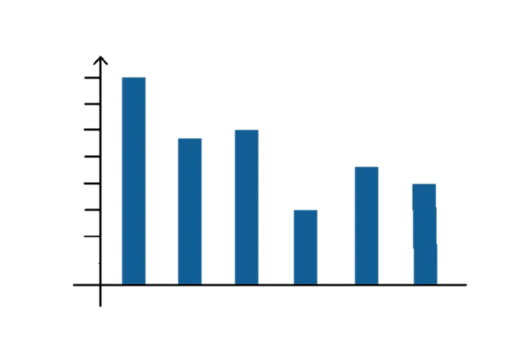
Popular Outputs of Data Visualization
Even before data visualization gained significant usage in the industry, many have seen the most basic yet popular results of data visualization: visual aids.
Examples of everyday visual aids that classify as outputs of data visualization are:
Bar graphs (compare data in certain groups)
Line graphs (outline change over time)
Pie charts (describe percentages as a whole)

Slide 5



Data Visualization with Big Data
Businesses work with an astronomically large amount of data generated and collected from multiple sources. To efficiently perform data visualization using this big data, companies can utilize the following platforms:
Tableau
Microsoft Power BI
D3.js

Slide 6
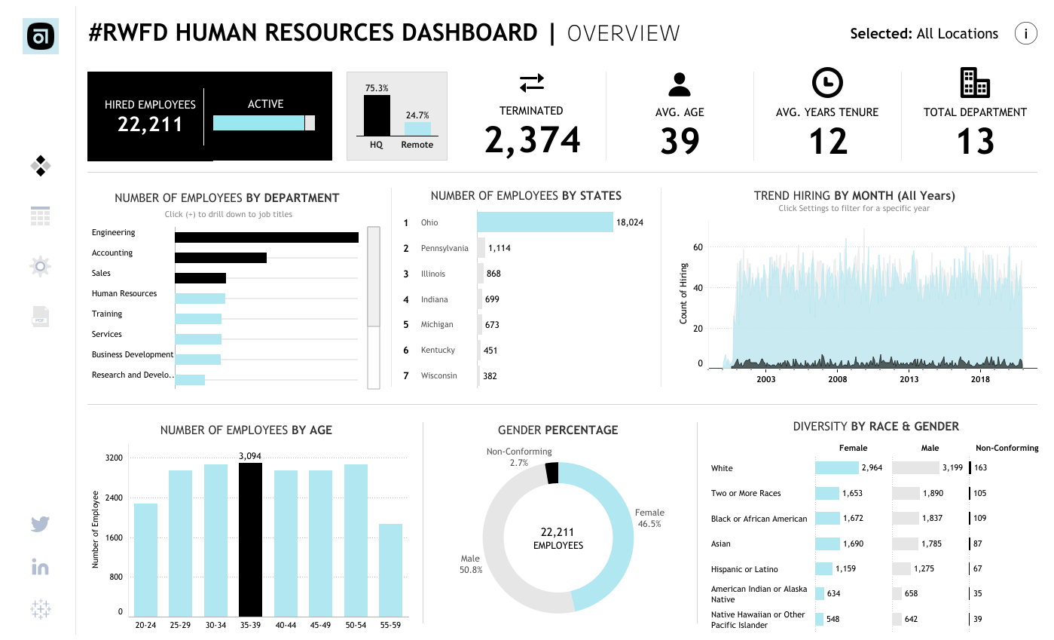
Real World Data Visualization: Tableau

Slide 7
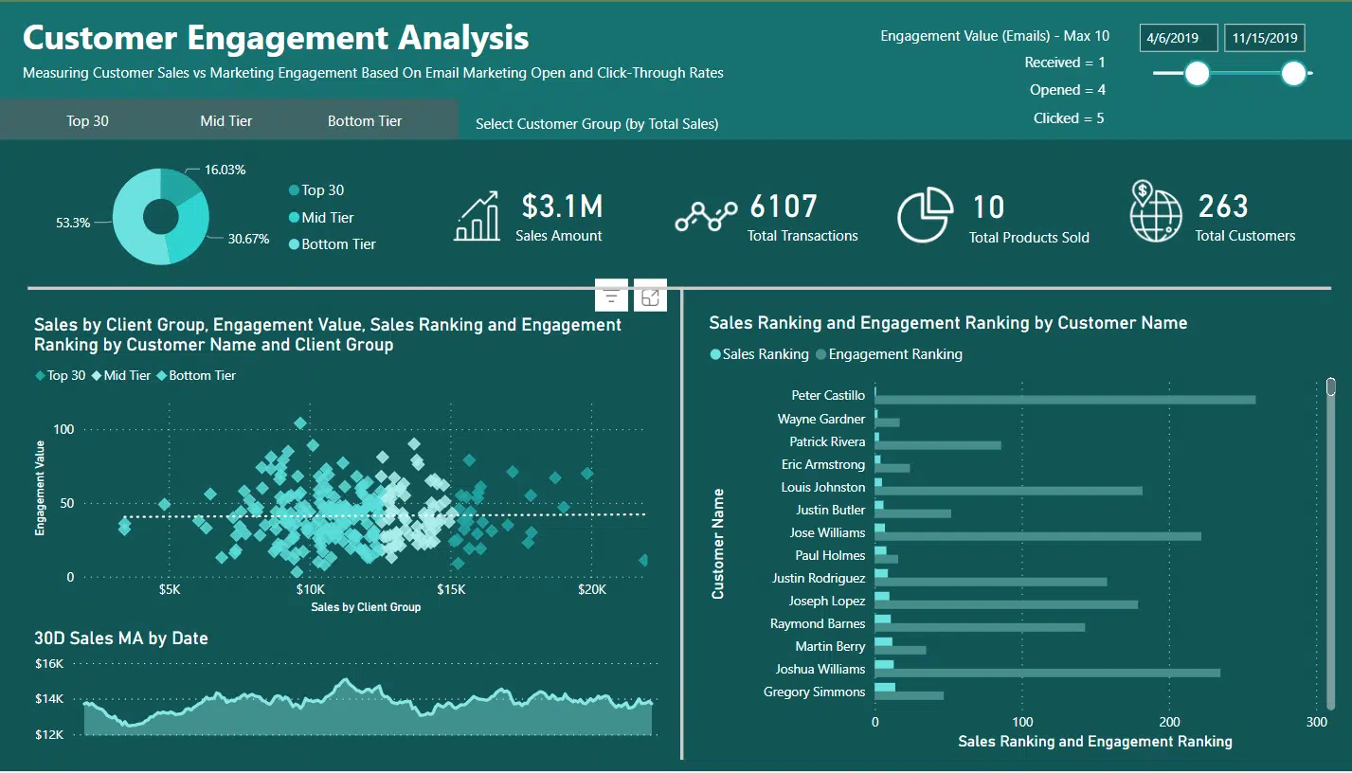
Real World Data Visualization: Power BI

Slide 8
Data is Art
Data visualized in such a way that tells a story that would never have been told is paramount to a business’s success.
Patterns found in the visual aid’s story can make or break the progression of a company problem being turned into a solution and potential advantage
Artistic display of big data through data visualization can lead to a breakthrough in a company’s ability to make data-driven decisions, which will ultimately lead to company growth

